Slide 1
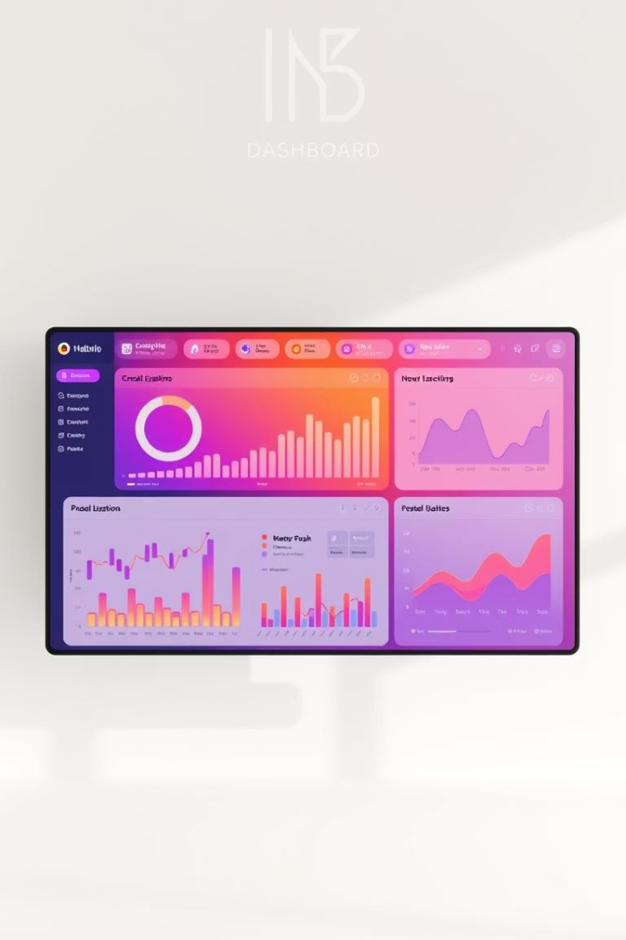
Interactive Sales Dashboard: Overview
This dashboard provides actionable insights for business stakeholders. It uses Power BI and a Sales/Financial dataset from Kaggle. The project aims to transform data into strategic decisions.

Slide 2
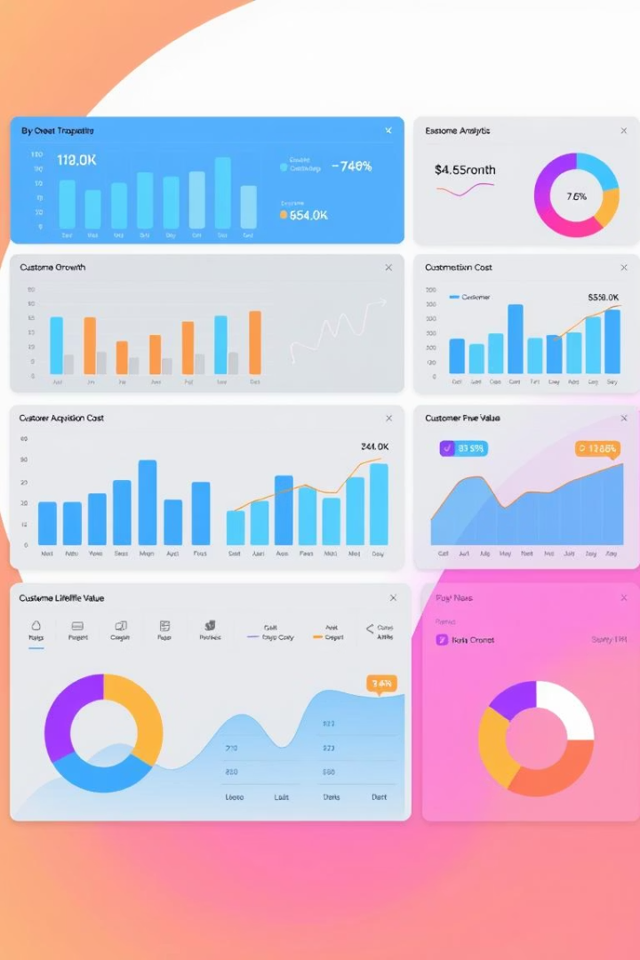
Defining Key Performance Indicators (KPIs)
1
Sales Performance
2
Profitability
Total Sales Revenue and Sales by Region.
Gross Profit Margin and Net Profit.
3
Growth Metrics
Sales Growth Rate (YoY) and Customer Acquisition Cost.
These KPIs are critical for evaluating business performance. They directly reflect strategic goals.

Slide 3
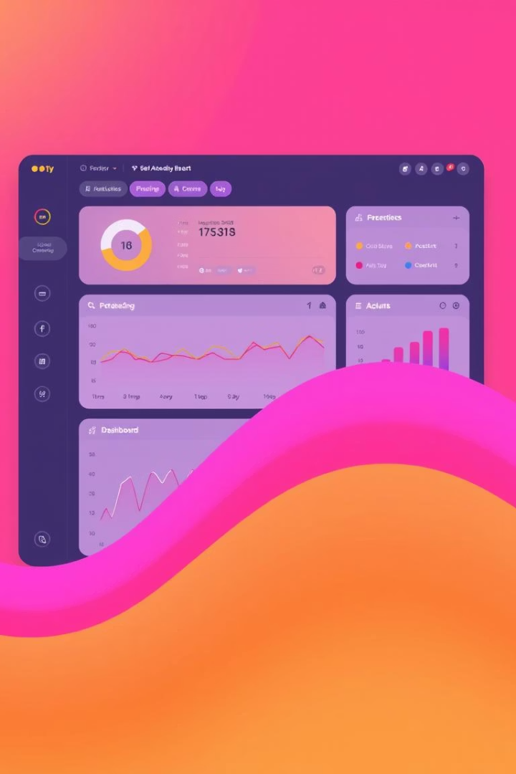
Dashboard Structure and Layout
Color Theme
Navigation Menu
Consistent blue and gray palette for a professional look.
Easy access to different dashboard sections (if possible).
Placement
Key elements placed for optimal user experience.
The dashboard's interactive features are designed for seamless navigation. This ensures efficient data exploration.

Slide 4
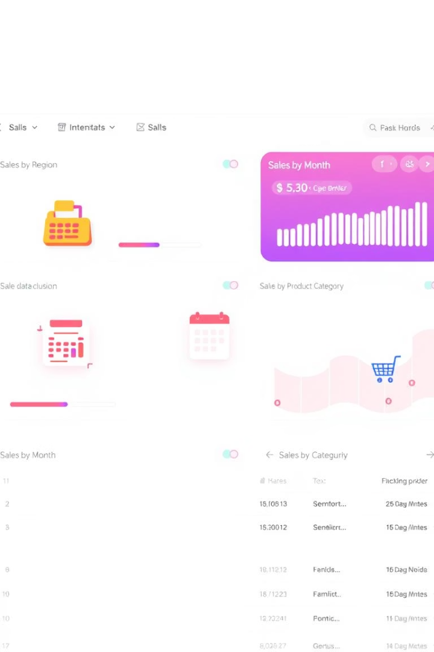




Interactive Slicers and Filters
Date Range
Product Category
Region
Customer Segment
These filters allow users to focus on specific data subsets. For example, analyze sales data for "Electronics" in "Q1 2024" in the "Northeast Region."

Slide 5




Time-Series Analysis
Line Chart
Sales Trends over Time (monthly, quarterly, yearly).
YoY Growth
Year-over-Year Growth Comparison.
Seasonality
Identifying peak sales periods.
Forecasting future sales trends using historical data provides insights. Tooltips show exact data values on hover.

Slide 6
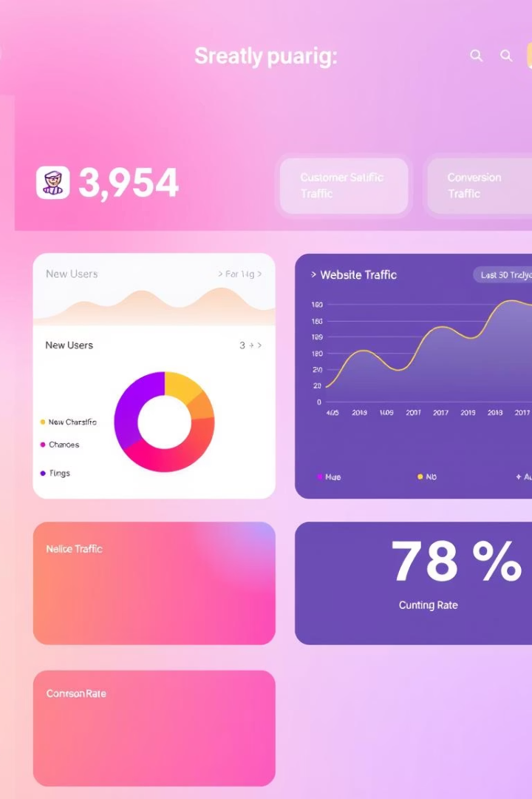
Summary Cards and Totals
$XXX
$YYY
Total Sales
Total Profit
Prominently displayed for quick reference.
Key profitability metric.
ZZZ
# Customers
Customer base overview.
Conditional formatting highlights key performance against goals. Also tracks Average Order Value (AOV).

Slide 7



Interactivity and Drill-Down Capabilities
Drill-Down
Regional sales data showing store performance.
Tooltips
Detailed information on data points.
Cross-Filtering
Region selection highlights corresponding charts.
Interactive map visualizations showcase geographical data. These enhance understanding and data exploration.

Slide 8



Conclusion and Key Takeaways
Next Steps
2
User training and feedback collection.
Applications
1
Potential for decision-making processes.
Improvements
Iterative enhancements based on user input.
3
The dashboard drives data-driven decisions. Continuous improvement is key.

